Slide 1
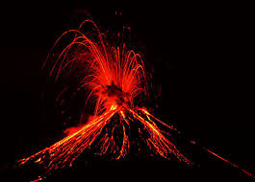
Volcanoes
Volcano

Slide 2
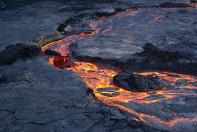
What is a volcano?
A volcano is a opening in the Earth’s crust
They let some power out of the Earth’s mantle
They are very destructive
Volcanic eruptions can be seen in space

Slide 3
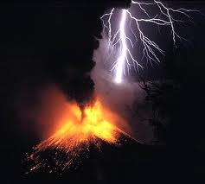
HOW DOES A VOLCANO HELP PEOPLE?
Make rich soil for farming
Obsidian (a volcanic rock) is used by people (weapons, tools, and ornaments).
Pumice (a volcanic rock) helps clean metal and wood.

Slide 4
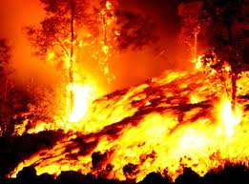
What is lava/magma?
Lava is melted rock
When a volcano erupts lava comes out
Lava is very hot (1,300 to 2,200’F)
If they cool they turn into rock and can make islands

Slide 5
How do we know a Volcano is going to erupt?
When dust or smoke start going up it means that the volcano is going to erupt
When there's an earthquake happens a volcano can also erupt
If you live near a volcano always check if an earthquake happens

Slide 6
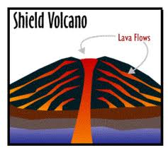
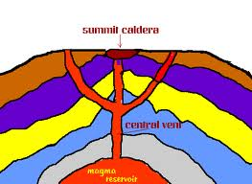
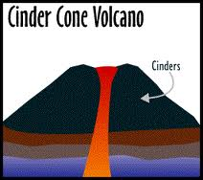
Types of volcanoes
There are 3 types of volcanoes: composite, shield, and cinder cone.
A cinder cone volcano shoots straight up.
A composite volcano shoots up but has little holes letting lava out.

Slide 7
How does it change to people that live near a volcano
One of the things that could happen is that there houses could get destroy.
Another thing that could happen is that f some one does not see the smoke and the volcano erupt they could die or get burn
They could also get rid of electricity and also rid of crops and also rid of trees or of furniture

Slide 8
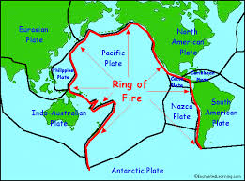
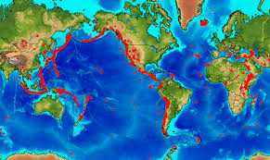
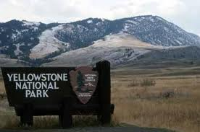
The location of volcanoes
Volcanoes are mostly found on the Ring of Fire
The strongest volcano on the world is found in Yellow Stone National Park

Slide 9
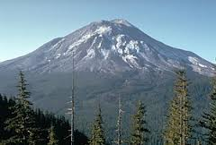
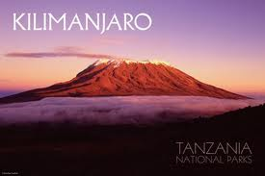
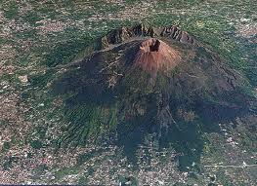
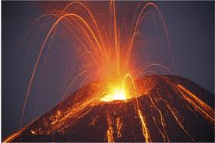
Famous Volcanoes
Mount St. Helens
Mount Kilimanjaro
Mount Vesuvius

Slide 10
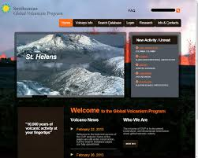
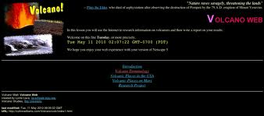
Bibliography
Weather Wiz Kids
Volcano Oregonstate Education
Geology Students
Brain Pop
BBC
Research Science
Volcanoes.usgs.gov
Be Ready
Nature Volcanoes (Our Website)

Slide 11
The End
Bye Bye
Hope You Had Fun
Check out our Website: naturalvolcanoes.weebly.com
Hope You liked It ☺ ☺
See You Later ☺ ☺

